Slide 1
Logic Gates

Slide 2
Objectives
Identify the basic gates and describe the behavior of each
Combine basic gates into circuits
Describe the behavior of a gate using Boolean expressions, truth tables, and logic diagrams

Slide 3
Definition
A gate is a device that performs a basic operation on electrical signals
Gates are combined into circuits to perform more complicated tasks
describing the behavior of gates and circuits by
Boolean expressions
logic diagrams
truth tables

Slide 4
Gates
six types of gates
NOT
AND
OR
XOR
NAND
NOR

Slide 5
NOT Gate
A NOT gate accepts one input value and produces one output value
By definition, if the input value for a NOT gate is 0, the output value is 1, and if the input value is 1, the output is 0
A NOT gate is sometimes referred to as an inverter because it inverts the input value

Slide 6
AND Gate
An AND gate accepts two input signals
If the two input values for an AND gate are both 1, the output is 1; otherwise, the output is 0

Slide 7
OR Gate
If the two input values are both 0, the output value is 0; otherwise, the output is 1

Slide 8
XOR Gate
XOR, or exclusive OR, gate
An XOR gate produces 0 if its two inputs are the same, and a 1 otherwise
Note the difference between the XOR gate and the OR gate; they differ only in one input situation
When both input signals are 1, the OR gate produces a 1 and the XOR produces a 0

Slide 9
NAND and NOR Gates
The NAND and NOR gates are essentially the opposite of the AND and OR gates, respectively

Slide 10
Review of Gate Processing
A NOT gate inverts its single input value
An AND gate produces 1 if both input values are 1
An OR gate produces 1 if one or the other or both input values are 1
An XOR gate produces 1 if one or the other (but not both) input values are 1
A NAND gate produces the opposite results of an AND gate
A NOR gate produces the opposite results of an OR gate

Slide 11
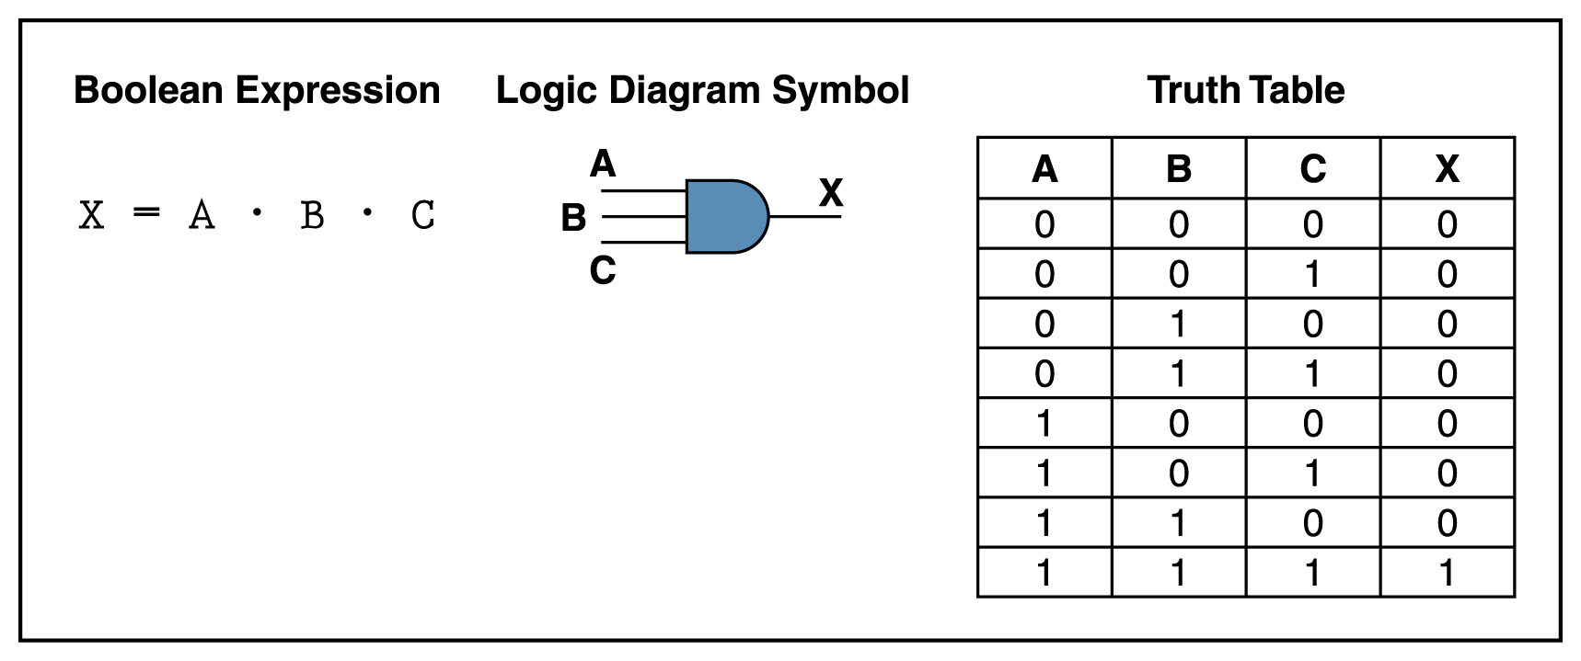
Gates with More Inputs
Gates can be designed to accept three or more input values
A three-input AND gate, for example, produces an output of 1 only if all input values are 1

Slide 12
Circuits
Two general categories
In a combinational circuit, the input values explicitly determine the output
In a sequential circuit, the output is a function of the input values as well as the existing state of the circuit
As with gates, we can describe the operations of entire circuits using three notations
Boolean expressions
logic diagrams
truth tables

Slide 13
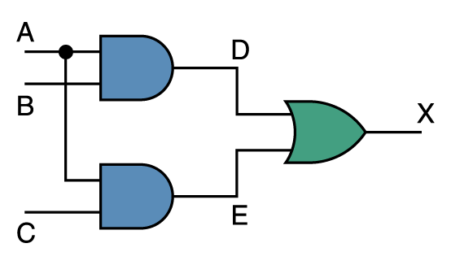
Combinational Circuits
Gates are combined into circuits by using the output of one gate as the input for another

Slide 14
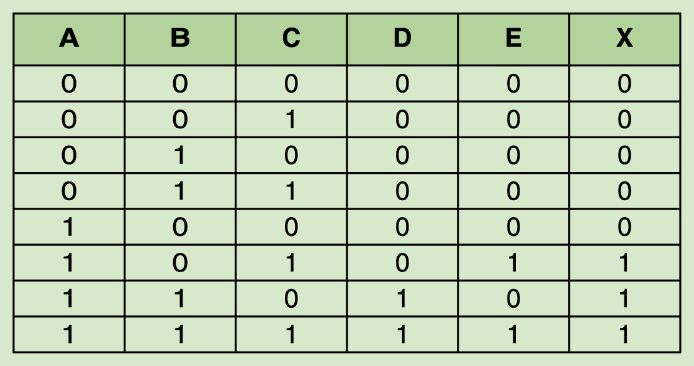
Combinational Circuits
Because there are three inputs to this circuit, eight rows are required to describe all possible input combinations
This same circuit using Boolean algebra:
(AB + AC)

Slide 15
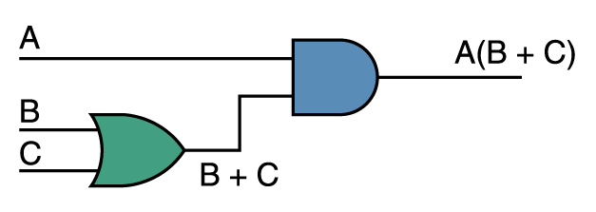
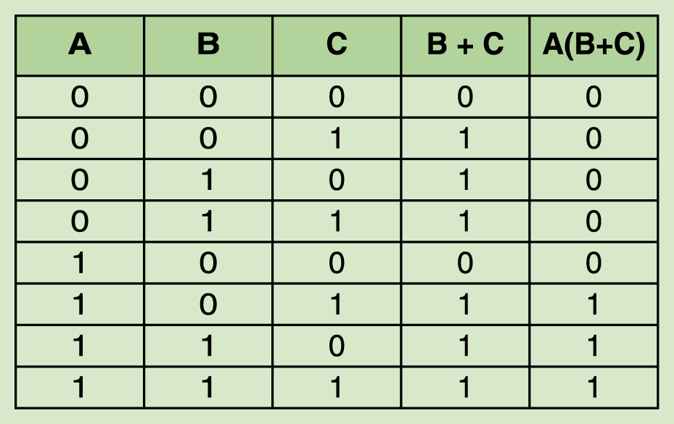
Now let’s go the other way; let’s take a Boolean expression and draw
Consider the following Boolean expression: A(B + C)
Now compare the final result column in this truth table to the truth table for the previous example
They are identical

Slide 16
Properties of Boolean Algebra

Slide 17
Adders
At the digital logic level, addition is performed in binary
Addition operations are carried out by special circuits called, appropriately, adders
The result of adding two binary digits could produce a carry value
Recall that 1 + 1 = 10 in base two
A circuit that computes the sum of two bits and produces the correct carry bit is called a half adder

Slide 18
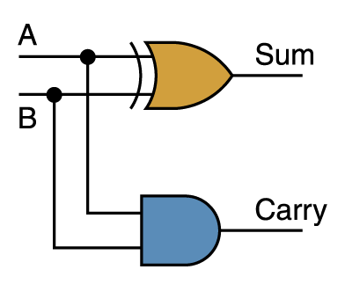
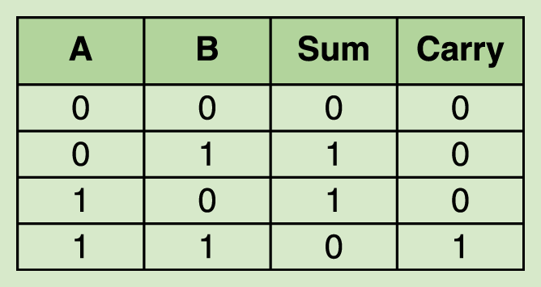
Adders
Circuit diagram representing a half adder
Two Boolean expressions:
sum = A ⊕ B
carry = AB

Slide 19
Integrated Circuits
Integrated circuits (IC) are classified by the number of gates contained in them

Slide 20
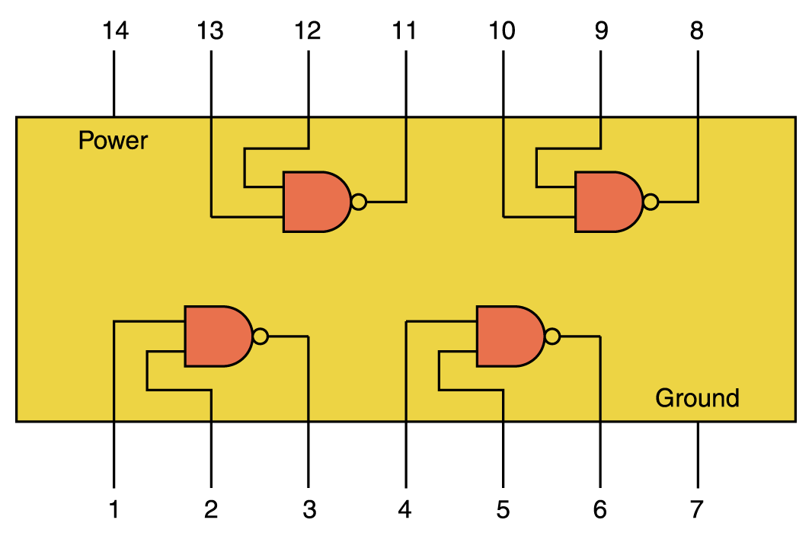
Integrated Circuits

Slide 21
CPU Chips
The most important integrated circuit in any computer is the Central Processing Unit, or CPU
Each CPU chip has a large number of pins through which essentially all communication in a computer system occurs

